Slide 1
Final Project Controlling scattering of light through topological transitions in all-dielectric metasurfaces
Sahana Bhattacharyya

Slide 2
Overall Idea
We design and fabricate a metasurface that supports radiative photonic modes in the near-infrared spectral range and exhibits a topological transition
The coupling of topological modes to the radiation continuum enables the observation of a topological transition, which is accompanied by the inversion of bright and dark modes, referred to as band-crossing.

Slide 3
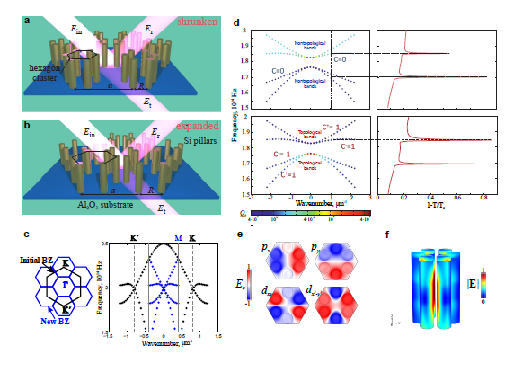
Problem Outline: to design new class of metasurfaces with unique scattering characteristics controlled via topological effects
https://arxiv.org/abs/1705.04236

Slide 4
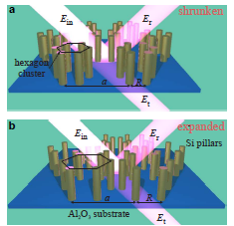
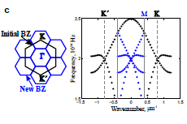
(a,b) Geometry of a metasurface composed of a triangular lattice of hexamers of Si pillars on a sapphire substrate: (a) shrunken structure with a/R > 3; (b) expanded structure with a/R < 3. lattice period a = 750 nm, radius of silicon pillars r = 75 nm and height of the pillars h = 1:0 micron. The sizes of the clusters R shown in Fig. (a,b) are chosen to be a/R = 3:15 and a/R = 2:85 for shrunken and expanded structures, respectively. (c) Left: the Brillouin zone of an unperturbed honeycomb lattice a/R = 3 (black) and the triangular lattice under study a/R ≠ 3 (blue) obtained by the honeycomb lattice deformation. Right: Shrinking/expanding the hexamer leads to folding of K and K’ points to Γ point in the new lattice. As the result of such symmetry reduction, valleys (pseudo-spins) mix, which may lead to a topological transition.

Slide 5
How to proceed in python
To generate the lattice structure Visual or Mayavi package is required.
Phonopy and Phono3py are open source packages that are required to solve the eigenmodes of the photonic structure. These two can calculate harmonic and quasi-harmonic levels, phonon-phonon interaction and lattice thermal conductivity calculations.
Brillouin Zone plot only matplotlib is required.

